Slide 1


Unit 5: Lesson 15
The weekend, finally

Slide 2


Slide 3


Slide 4
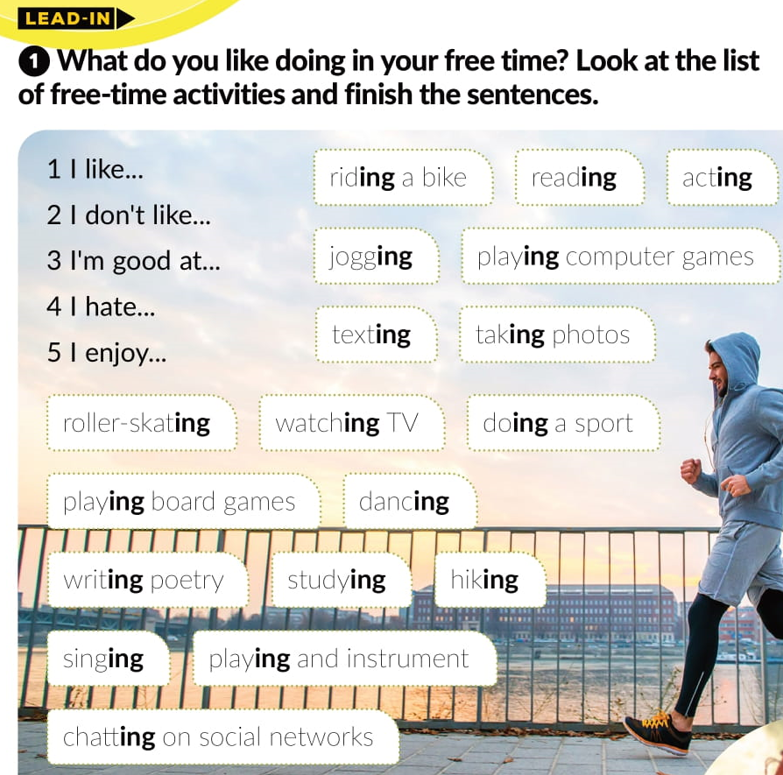
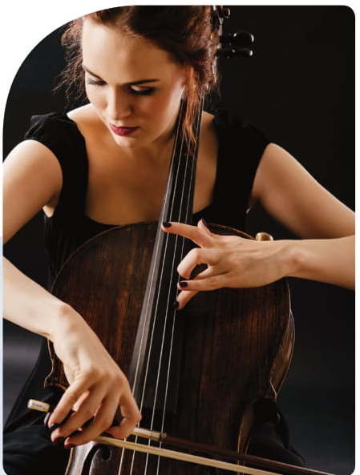

Slide 5
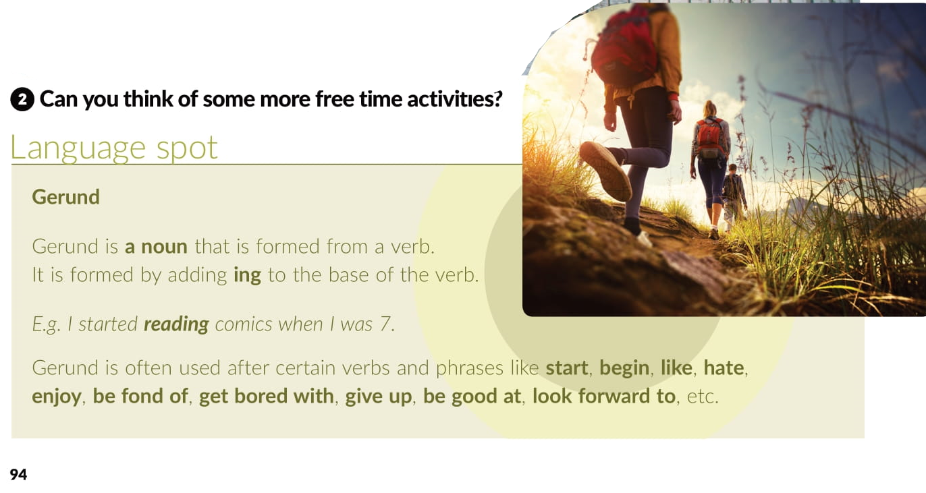

Slide 6

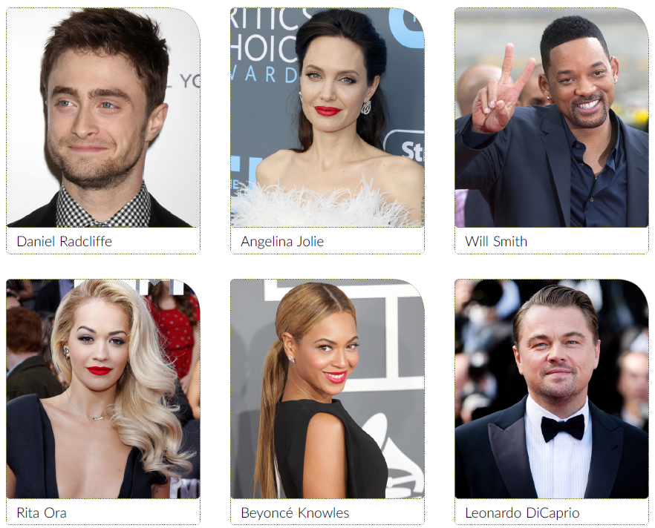








https://www.e-sfera.hr/dodatni-digitalni-sadrzaji/85156e51-6b6f-472d-b8a0-c2ad075ff87c/assets/audio/25_l15___celebrities_and_their_hobbies.mp3

Slide 7
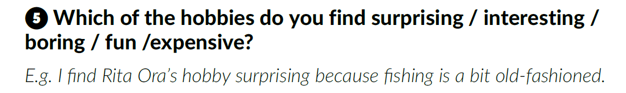
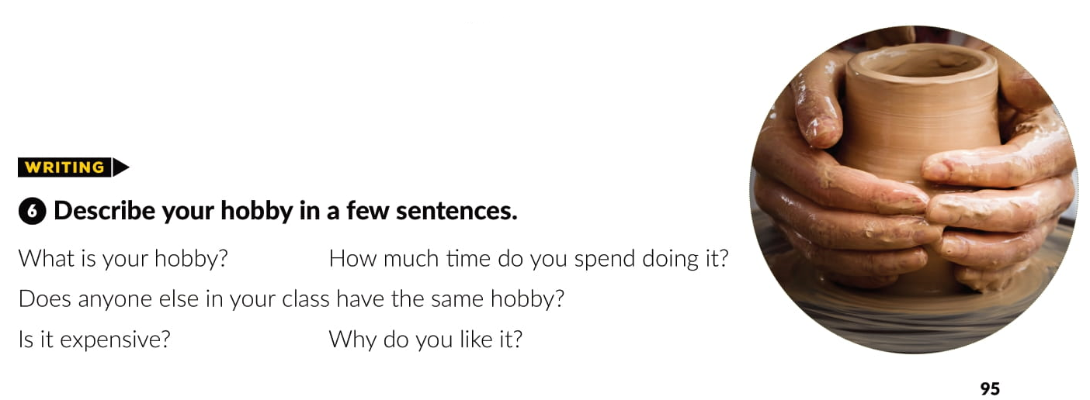

Slide 8
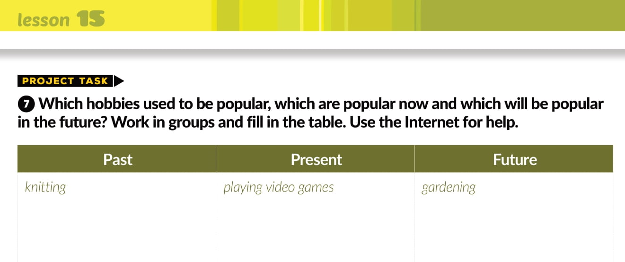
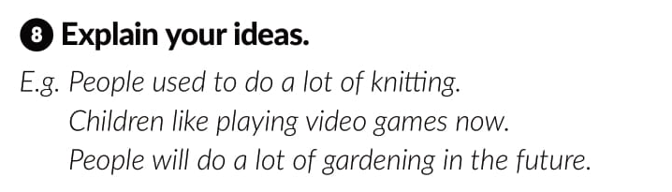

Slide 9

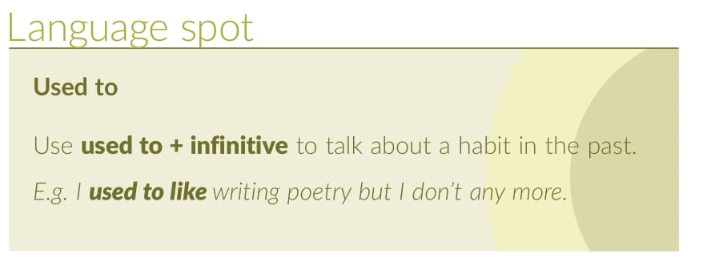

Slide 10
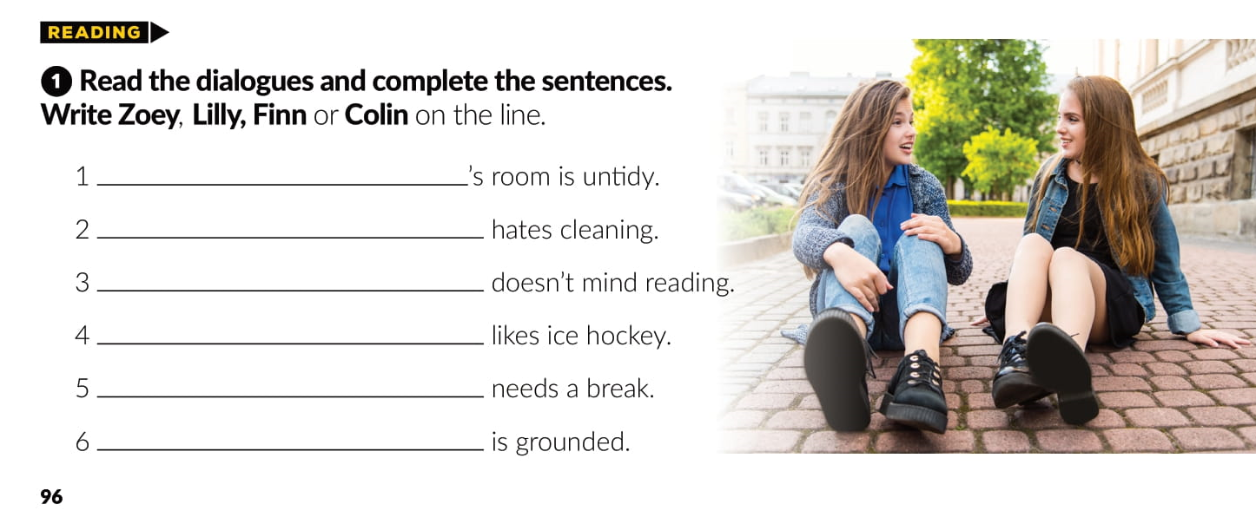
Lilly
Zoey
Lilly
Finn
Collin
Collin

Slide 11
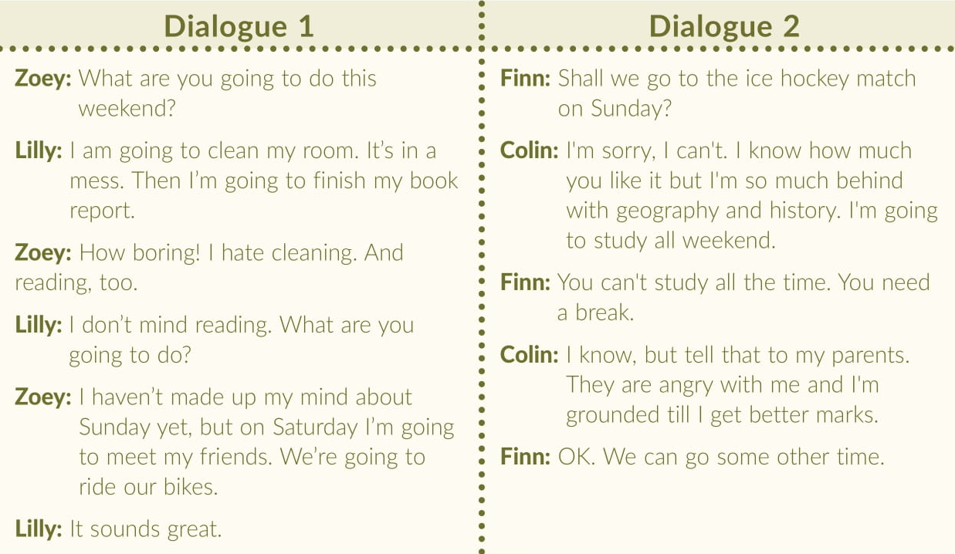

Slide 12
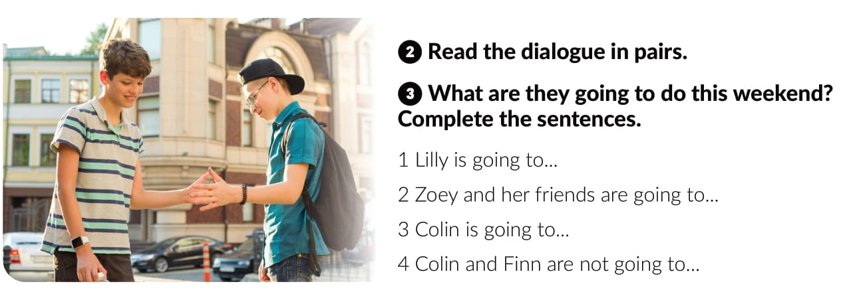
clean her room.
ride their bikes.
study all weekend.
go to the ice hockey match

Slide 13
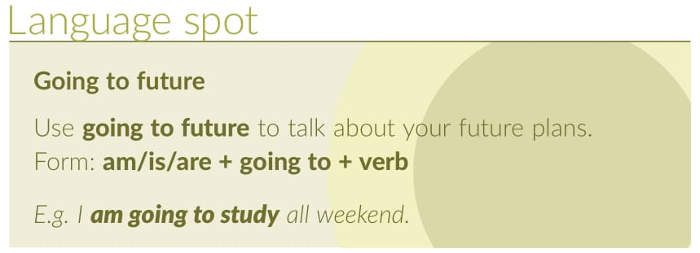
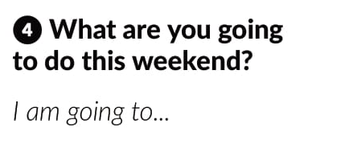

Slide 14
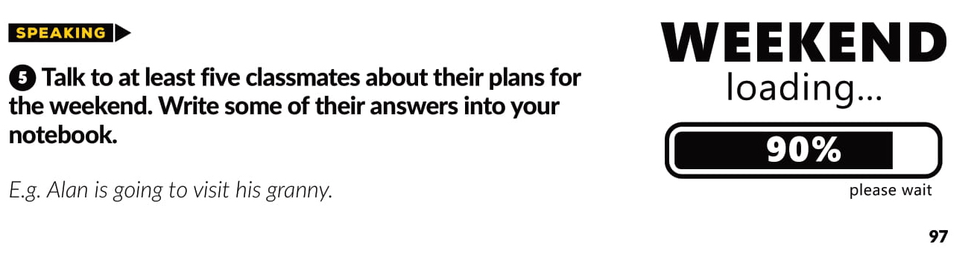

Slide 15
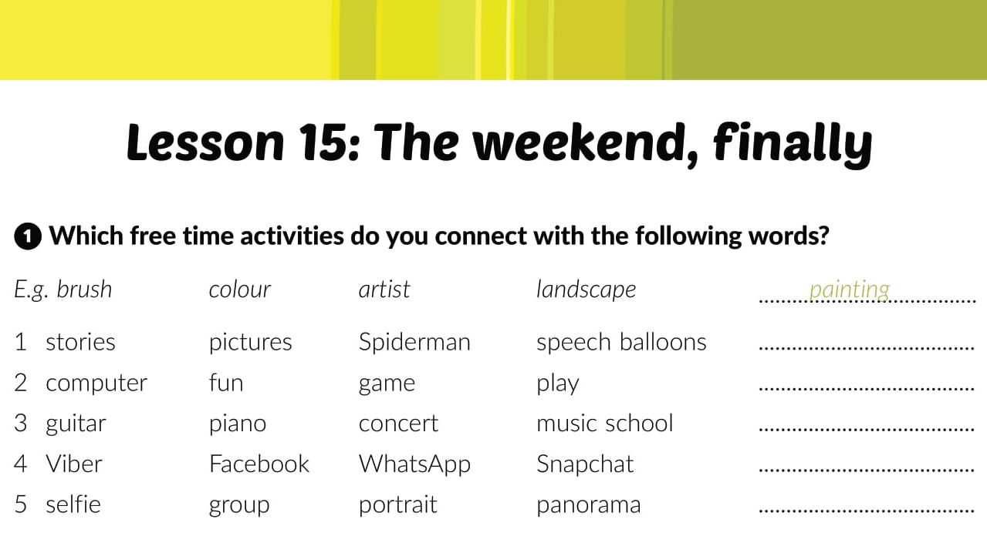
Workbook, page 66
reading cartoons
playing computer games
playing music
chatting
taking photographs

Slide 16
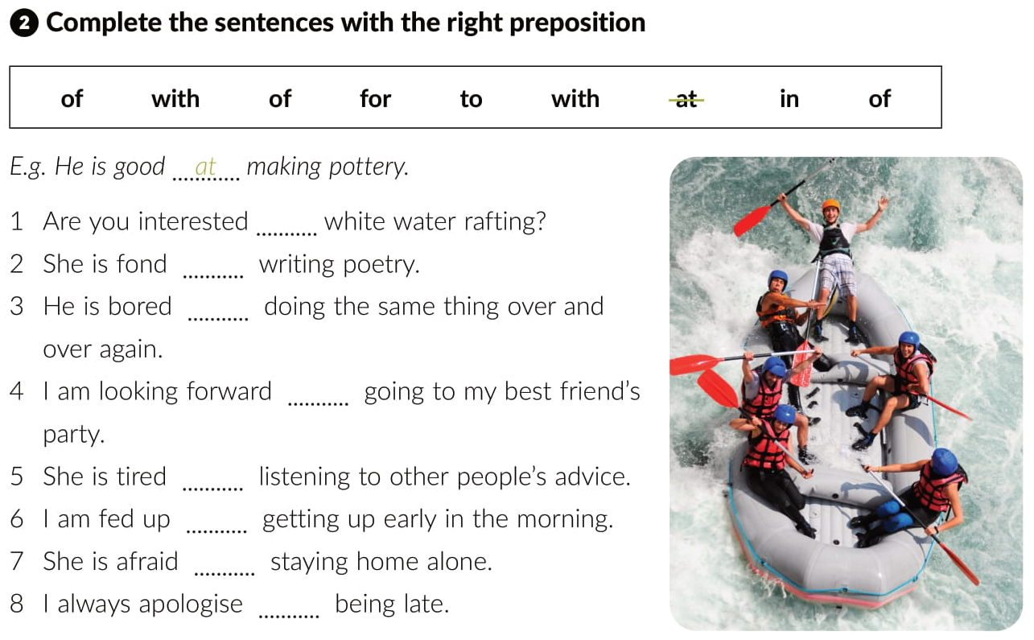
in
of
with
to
of
with
of
for

Slide 17
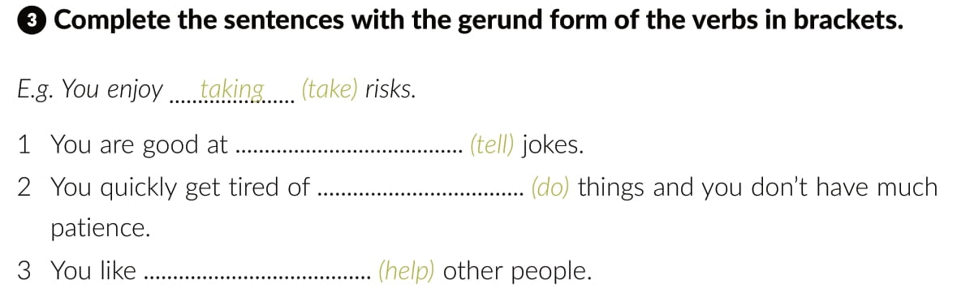

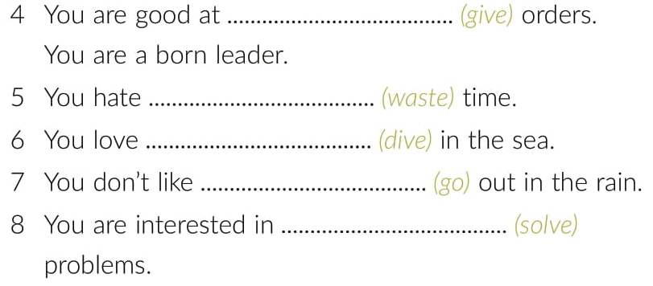
telling
doing
helping
giving
wasting
diving
going
solving

Slide 18
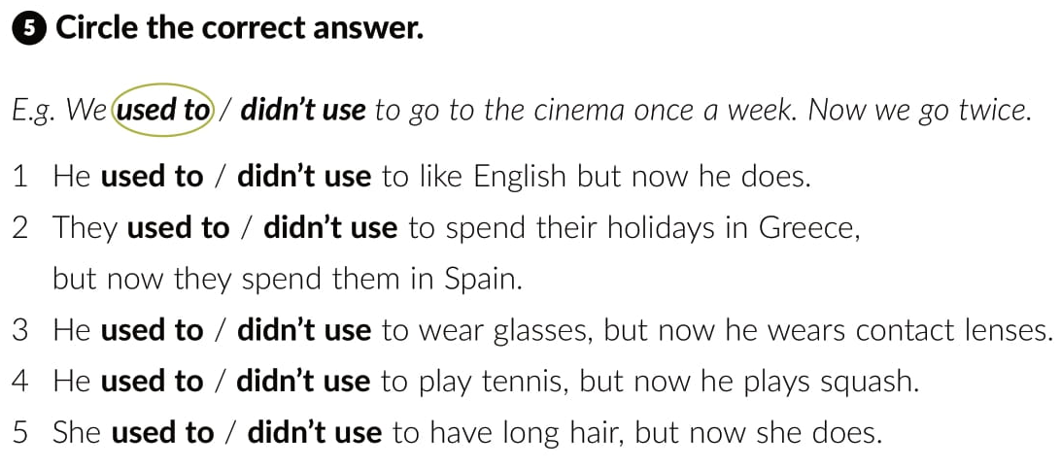

Slide 19
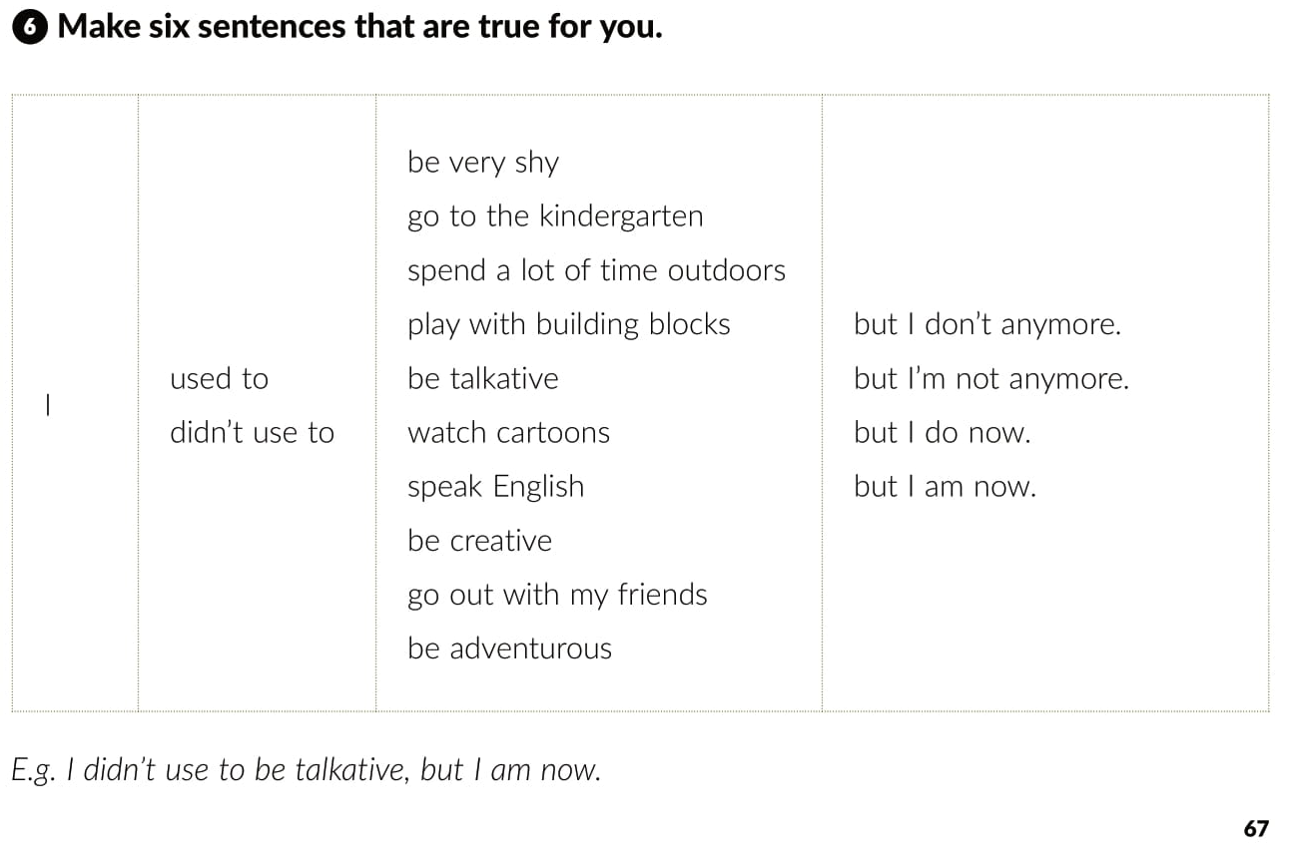

Slide 20


Slide 21
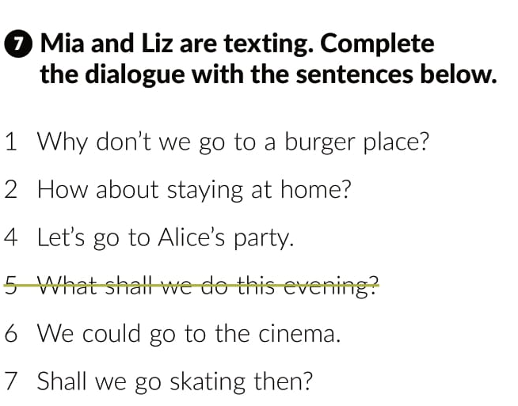
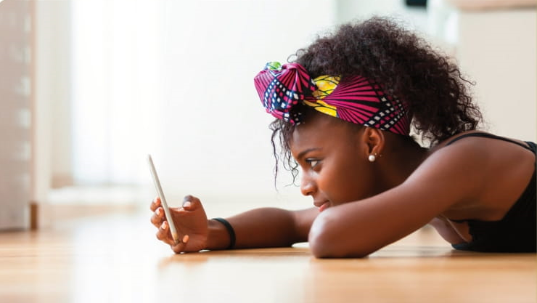

Slide 22
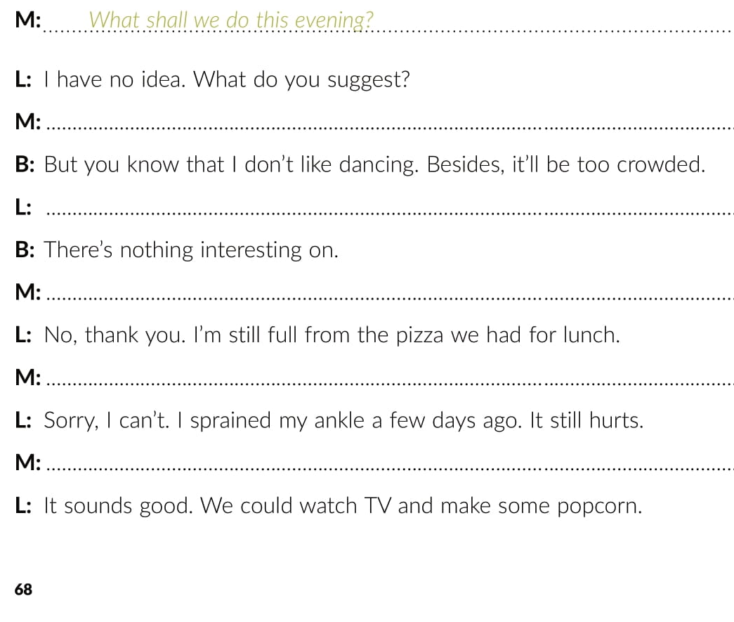
Let’s go to Alice’s party.
We could go to the cinema.
Why don’t we go to a burger place?
Shall we go skating then?
How about staying at home?.

Slide 23
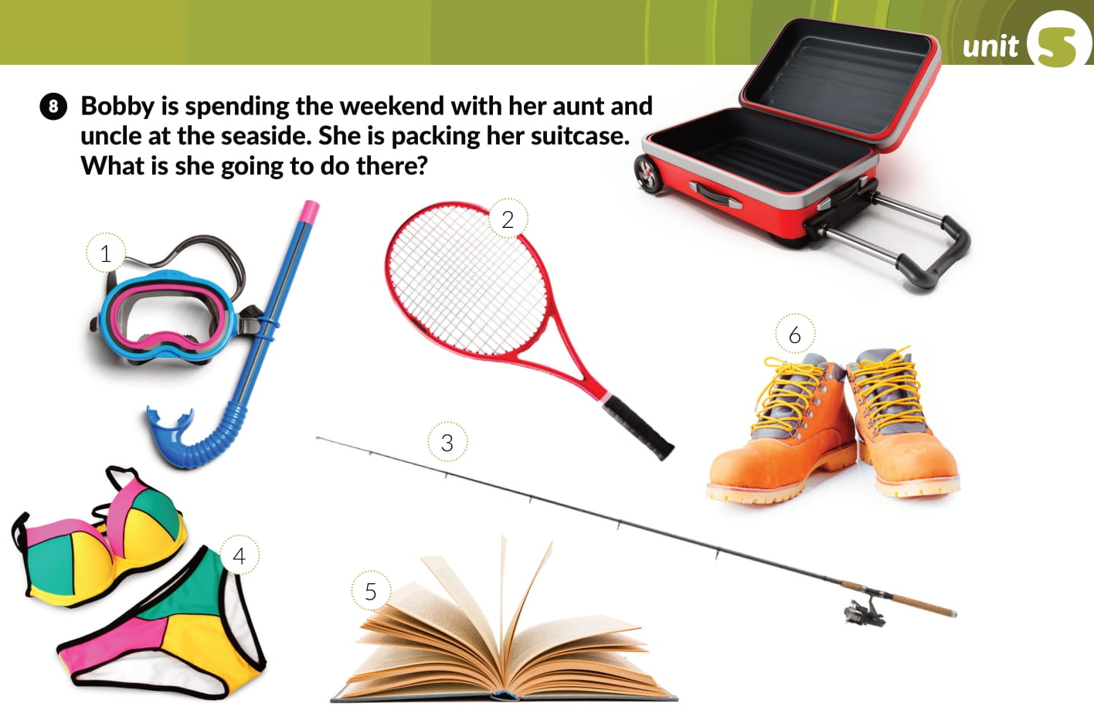
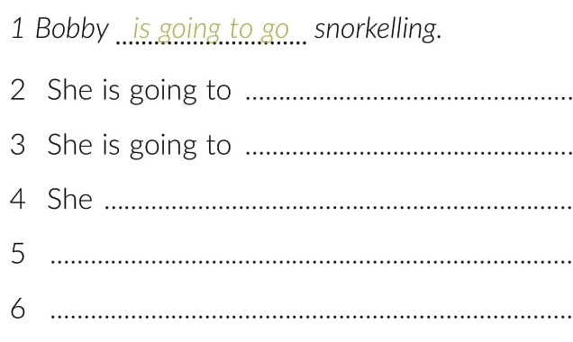
play tennis .
go fishing.
is going to go swimming..
She is going to read a book.
She is going to go hiking.

Slide 24
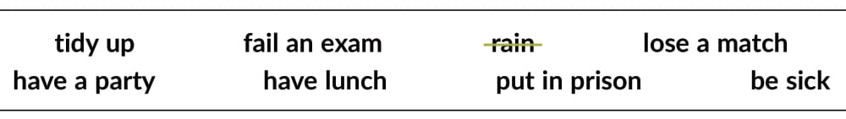
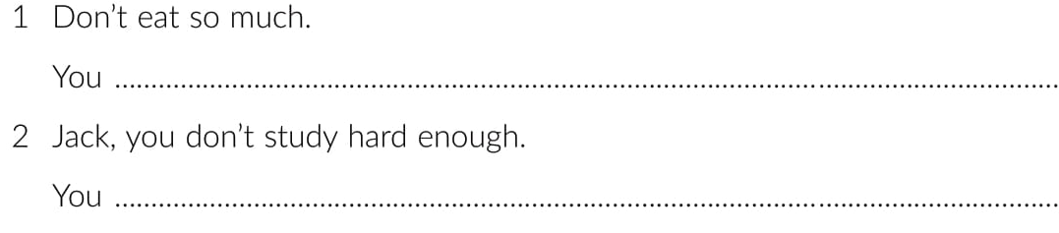
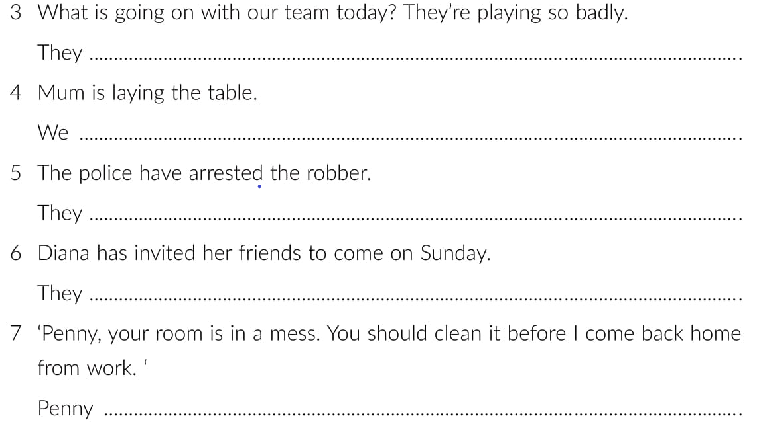
are going to be sick.
are going to fail an exam.
are going to lose a match.
are going to have lunch.
are going to put him in prison.
are going to have a party.
is going to tidy up.

Slide 25
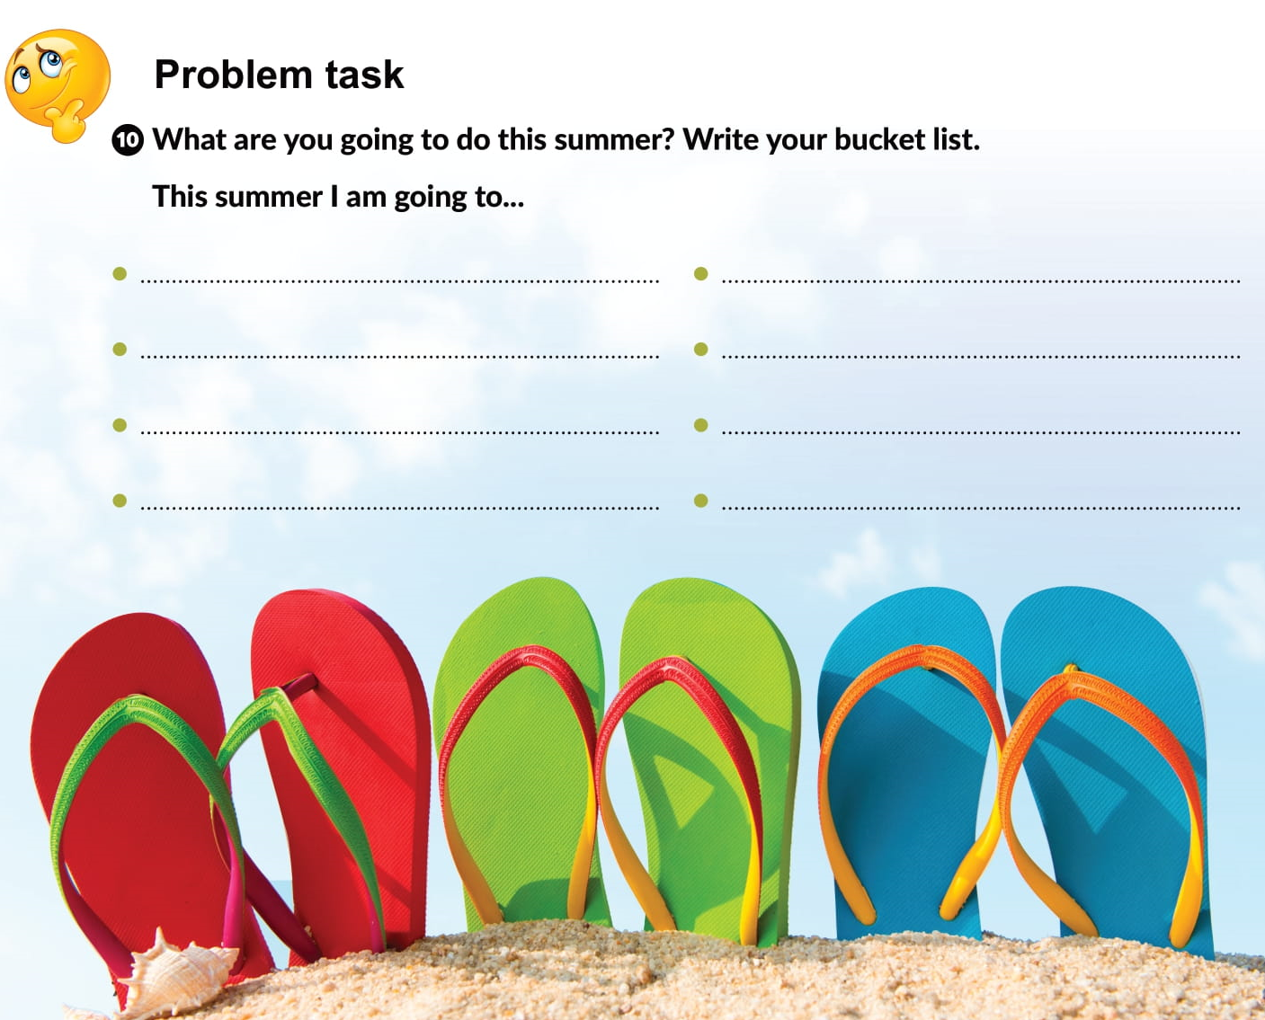

Slide 26

Otvori sljedeću poveznicu, te odaberi PLAY AND LEARN!
Lesson 15 The weekend, finally | Way to go 4 (e-sfera.hr)

